Slide 1
Chapter 4 Quantum Numbers and e- configurations
Last Updated November 13, 2013

Slide 2
Bohr Model of the Hydrogen Atom
Niels Bohr proposed a hydrogen-atom model that linked the atom’s electron to photon emission.
According to the model, the electron can circle the nucleus only in allowed paths, or orbits.

Slide 3
Bohr Model of the Hydrogen Atom
When an electron falls to a lower energy level, a photon is emitted, and the process is called emission.

Slide 4
Photon Emission and Absorption

Slide 5
Electrons as Waves
French scientist Louis de Broglie suggested that electrons be considered waves confined to the space around an atomic nucleus.
It followed that the electron waves could exist only at specific frequencies.

Slide 6
The Heisenberg Uncertainty Principle
German physicist Werner Heisenberg proposed that any attempt to locate a specific electron with a photon knocks the electron off its course.
The Heisenberg uncertainty principle states that it is impossible to determine simultaneously both the position and velocity of an electron or any other particle.

Slide 7
The Schrödinger Wave Equation
In 1926, Austrian physicist Erwin Schrödinger developed an equation that treated electrons in atoms as waves.
The Schrödinger wave equation laid the foundation for modern quantum theory.
Quantum theory describes mathematically the wave properties of electrons and other very small particles.

Slide 8
The Schrödinger Wave Equation
Electrons do not travel around the nucleus in neat orbits, as Bohr had postulated.
Instead, they exist in certain regions called orbitals.
An orbital is a three-dimensional region around the nucleus that indicates the probable location of an electron.

Slide 9
Atomic Orbitals and Quantum Numbers
Quantum numbers
The principal quantum number, symbolized by n, indicates the main energy level occupied by the electron.
The angular momentum quantum number, symbolized by l, indicates the shape (Sub-level) of the orbital.

Slide 10
Atomic Orbitals and Quantum Numbers
The magnetic quantum number, symbolized by m_{l}, indicates the orientation of an orbital around the nucleus.
The spin quantum number m_{s} has only two possible values—(+1/2 , −1/2)—which indicate the two fundamental spin states of an electron in an orbital.

Slide 11
Shapes of s, p, and d Orbitals

Slide 12
f block orbitals

Slide 13
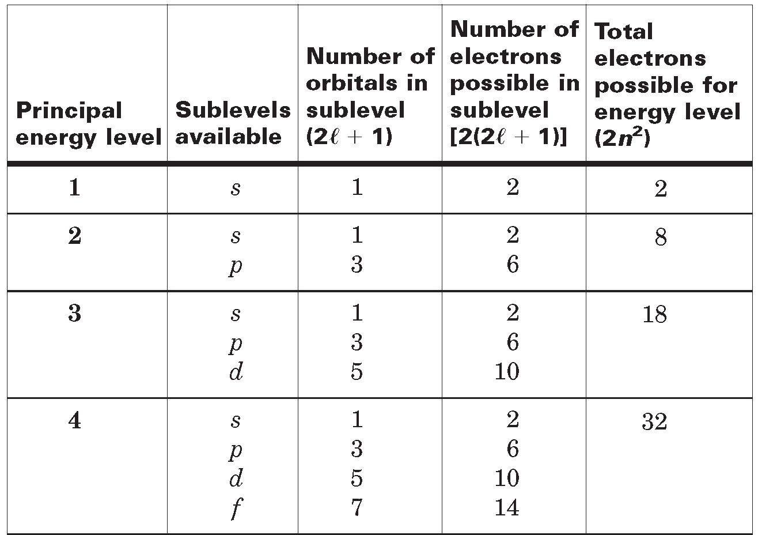
Electrons Accommodated in Energy Levels and Sublevels

Slide 14
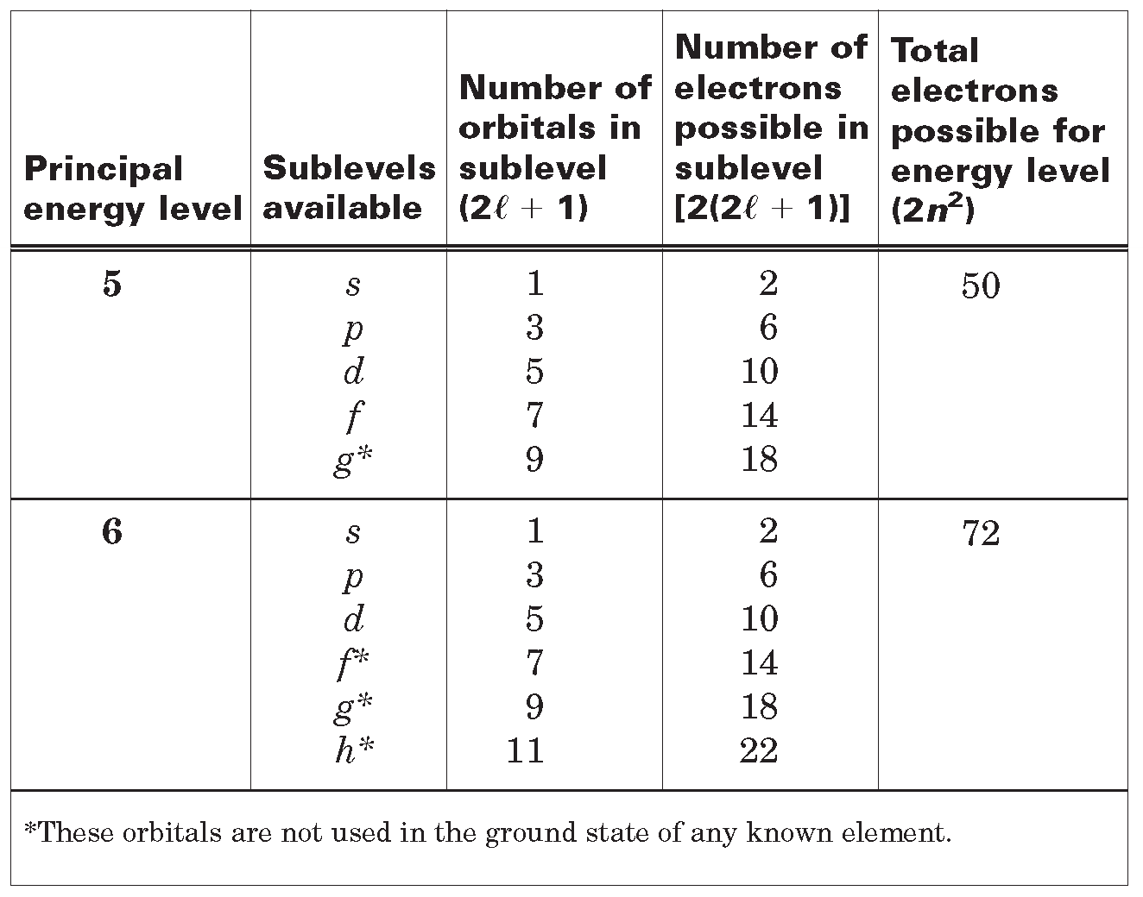
Electrons Accommodated in Energy Levels and Sublevels

Slide 15
Quantum Numbers of the First 30 Atomic Orbitals

Slide 16
Electron Configurations
The arrangement of electrons in an atom is known as the atom’s electron configuration.
The lowest-energy arrangement of the electrons for each element is called the element’s ground-state electron configuration.

Slide 17
Relative Energies of Orbitals

Slide 18
aufbau diagram

Slide 19
Rules Governing Electron Configurations
According to the Aufbau principle, an electron occupies the lowest-energy orbital that can receive it.
According to the Pauli exclusion principle, no two electrons in the same atom can have the same set of four quantum numbers.

Slide 20
Rules Governing Electron Configurations
Hund’s rule, orbitals of equal energy are each occupied by one electron before any orbital is occupied by a second electron, and all electrons in singly occupied orbitals must have the same spin state.

Slide 21
Representing Electron Configurations
Orbital Notation
An unoccupied orbital is represented by a line, with the orbital’s name written underneath the line.
An orbital containing one electron is represented as:

Slide 22
Discuss
Orbital Diagrams
Quantum Numbers
e- congifurations
(Noble Gas Notation) or short orbital e- config
Discuss Lewis Dot or e- Dot

Slide 23
e- Config Practice

Slide 24
Orbital Diagram Practice

Slide 25
Quantum numbers

Slide 26
Noble Gas Notation

Slide 27
Lewis Dot

