Slide 1
Honors Chemistry
Chapter 6
Covalent Bonding and Lewis Structures
Last Updated January 3, 2018

Slide 2
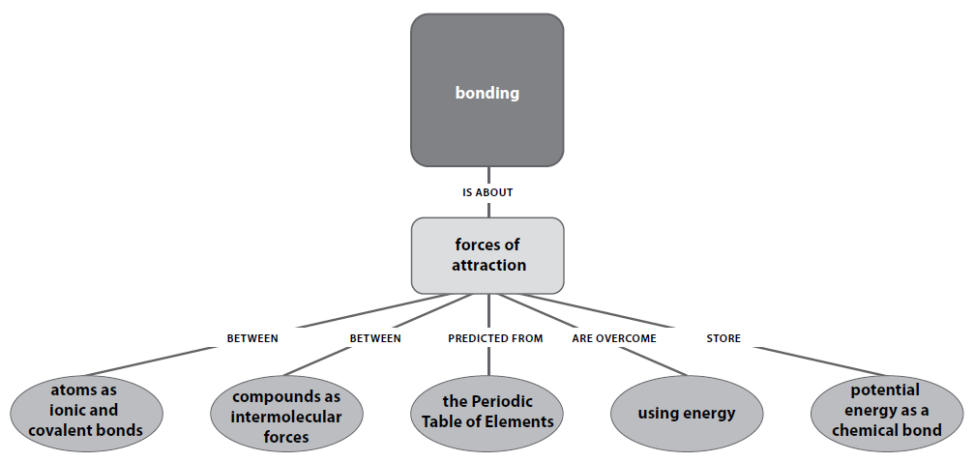
Priority Standards

Slide 3
Big Idea
There are attractions between atoms that increase their stability.

Slide 4
Core Concepts
A chemical bond is the electrostatic attraction between two or more atoms. Chemical potential energy is stored in chemical bonds.
Chemical reactions involve breaking bonds in reactants (endothermic) and forming new bonds in the products (exothermic).
The forces of attraction that occur between molecules (called intermolecular forces) are influenced by molecular polarity. Molecular polarity is dependent on bond polarity (polar or nonpolar) and the shape of the molecule.

Slide 5
Molecular Compounds
A molecule is a neutral group of atoms that are held together by covalent bonds.
A chemical compound whose simplest units are molecules is called a molecular compound.

Slide 6
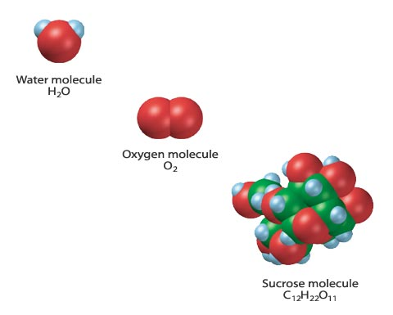

Molecule

Slide 7
Molecular Compounds
A chemical formula indicates the relative numbers of atoms of each kind in a chemical compound by using atomic symbols and numerical subscripts. (Similar to empirical formulas-simplest or lowest whole number ratio of elements in a compound)
A molecular formula shows the types and numbers of atoms combined in a single molecule of a molecular compound.
Structural Formula→ most specific formula

Slide 8
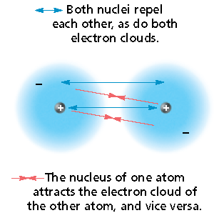
Formation of a Covalent Bond
The electron of one atom and proton of the other atom attract one another.
The two nuclei and two electrons repel each other.
These two forces cancel out to form a covalent bond at a length where the potential energy is at a minimum.

Slide 9
Characteristics of the Covalent Bond
The distance between two bonded atoms at their minimum potential energy (the average distance between two bonded atoms) is the bond length.
In forming a covalent bond, the hydrogen atoms release energy. The same amount of energy must be added to separate the bonded atoms.
Bond energy is the energy required to break a chemical bond and form neutral isolated atoms.

Slide 10
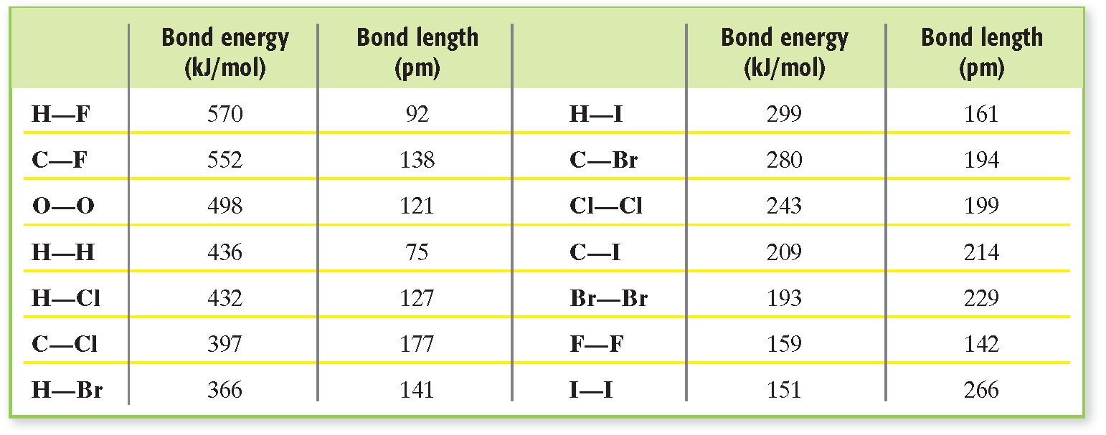
Bond Energies and Bond Lengths for Single Bonds

Slide 11
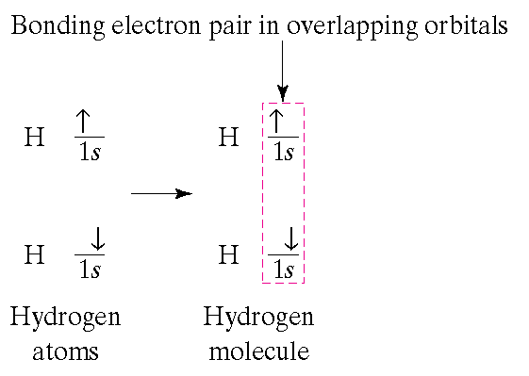
Characteristics of the Covalent Bond
When two atoms form a covalent bond, their shared electrons form overlapping orbitals.
This achieves a noble-gas configuration.
The bonding of two hydrogen atoms allows each atom to have the stable electron configuration of helium, 1s².

Slide 12
THE OCTET RULE: Chemical compounds tend to form so that each atom, by gaining, losing, or sharing electrons, has an octet of electrons in its highest energy level.

Slide 13
The Octet Rule, continued
Exceptions to the Octet Rule
Exceptions to the octet rule include those for atoms that cannot fit eight electrons, and for those that can fit more than eight electrons, into their outermost orbital.
  Hydrogen
  Boron
  Main-group elements in Periods 3 can form bonds with expanded valence

Slide 14
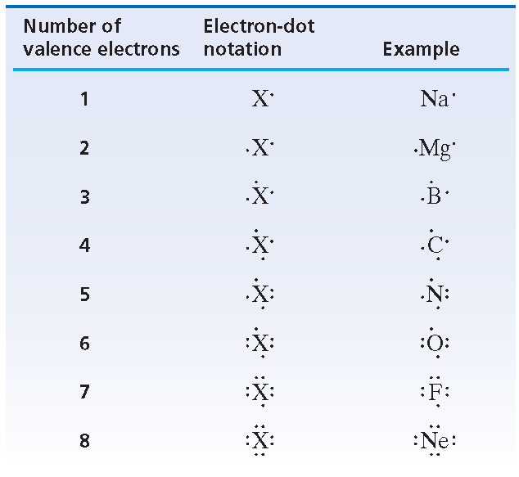
Electron-Dot Notation
Electron-dot notation is an electron-configuration notation in which only the valence electrons of an atom of a particular element are shown, indicated by dots placed around the element’s symbol. The inner-shell electrons are not shown.

Slide 15


Lewis Structures
Electron-dot notation can also be used to represent molecules.
The pair of dots between the two symbols represents the shared electron pair of the hydrogen-hydrogen covalent bond.
  For a molecule of fluorine, F₂, the electron-dot notations of two fluorine atoms are combined.

Slide 16


Lewis Structures
The pair of dots between the two symbols represents the shared pair of a covalent bond.
In addition, each fluorine atom is surrounded by three pairs of electrons that are not shared in bonds.
An unshared pair, also called a lone pair, is a pair of electrons that is not involved in bonding and that belongs exclusively to one atom.

Slide 17

Lewis Structures
The pair of dots representing a shared pair of electrons in a covalent bond is often replaced by a long dash.
  example:
A structural formula indicates the kind, number, and arrangement, and bonds but not the unshared pairs of the atoms in a molecule.
  example: F–F H–Cl

Slide 18
Lewis Structures
The Lewis structures and the structural formulas for many molecules can be drawn if one knows the composition of the molecule and which atoms are bonded to each other.
A single covalent bond, or single bond, is a covalent bond in which one pair of electrons is shared between two atoms.

Slide 19
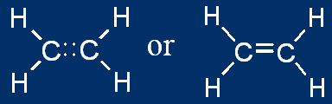
Multiple Covalent Bonds
A double covalent bond, or simply a double bond, is a covalent bond in which two pairs of electrons are shared between two atoms.
  Double bonds are often found in molecules containing carbon, nitrogen, and oxygen.
A double bond is shown either by two side-by-side pairs of dots or by two parallel dashes.

Slide 20

Multiple Covalent Bonds
A triple covalent bond, or simply a triple bond, is a covalent bond in which three pairs of electrons are shared between two atoms.
  example 1—diatomic nitrogen:
  example 2—ethyne, C₂H₂:

Slide 21
Multiple Covalent Bonds
Double and triple bonds are referred to as multiple bonds, or multiple covalent bonds.
  In general, double bonds have greater bond energies and
  are shorter than single bonds.
  Triple bonds are even stronger and shorter than
  double bonds.
When writing Lewis structures for molecules that contain carbon, nitrogen, or oxygen, remember that multiple bonds between pairs of these atoms
are possible.

Slide 22
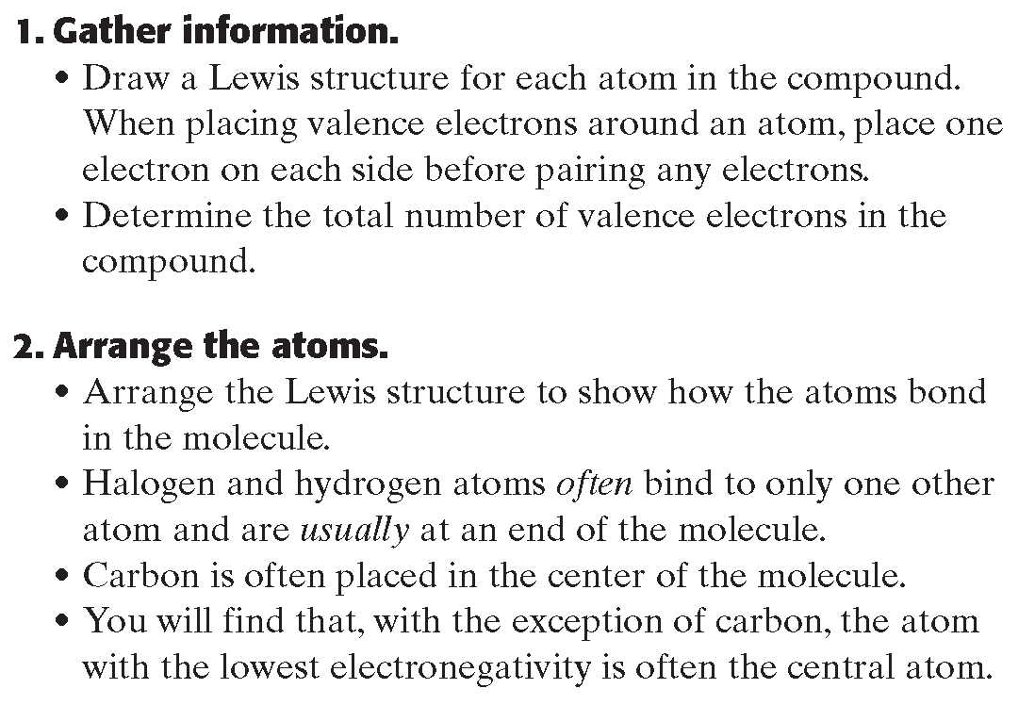
Drawing Lewis Structures with Many Atoms

Slide 23
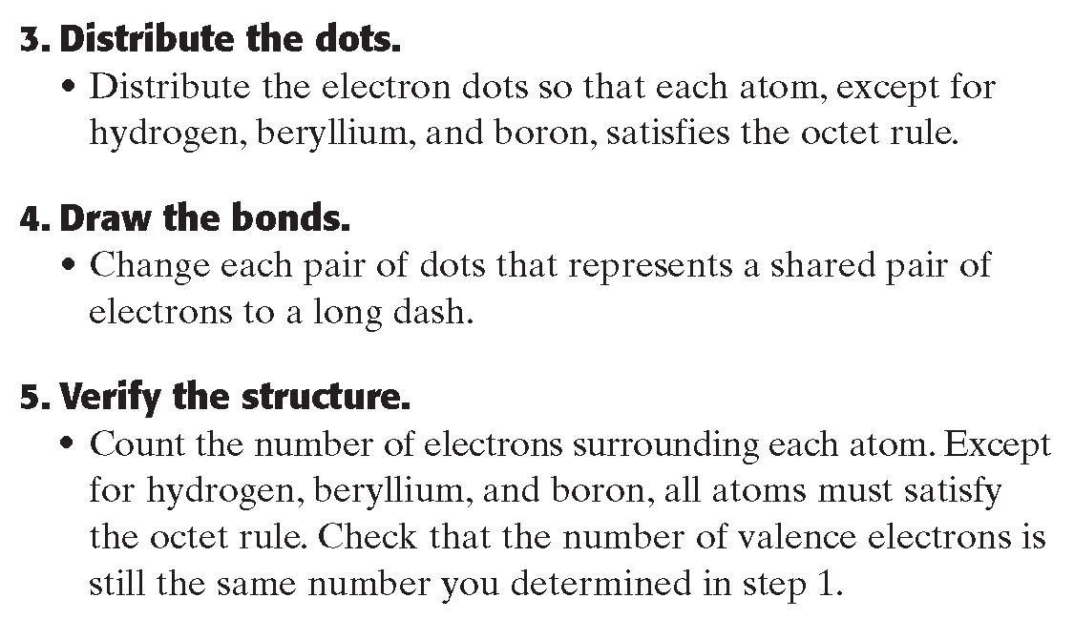
Drawing Lewis Structures with Many Atoms

Slide 24
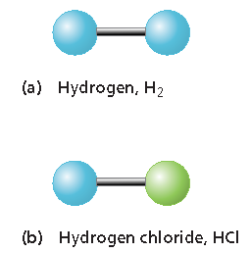
VSEPR Theory
As shown at right, diatomic molecules, like those of
(a) hydrogen, H₂, and
(b) hydrogen chloride, HCl,
can only be linear because
they consist of only two atoms.
To predict the geometries of more-complicated molecules, one must consider the locations of all electron pairs surrounding the bonding atoms. This is the basis of VSEPR theory.

Slide 25

VSEPR Theory
The abbreviation VSEPR (say it “VES-pur”) stands for “valence-shell electron-pair repulsion.”
VSEPR theory states that repulsion between the sets of valence-level electrons surrounding an atom causes these sets to be oriented as far apart as possible.
  example: BeF₂
  The central beryllium atom is surrounded by only the two electron pairs it shares with the fluorine atoms.
  According to VSEPR, the shared pairs will be as far away from each other as possible, so the bonds to fluorine will be 180° apart from each other.
  The molecule will therefore be linear:

Slide 26
VSEPR Theory
Representing the central atom in a molecule by A and the atoms bonded to the central atom by B, then according to VSEPR theory, BeF₂ is an example of an AB₂ molecule, which is linear.
In an AB₃ molecule, the three A–B bonds stay farthest apart by pointing to the corners of an equilateral triangle, giving 120° angles between the bonds.
In an AB₄ molecule, the distance between electron pairs is maximized if each A–B bond points to one of four corners of a tetrahedron.

Slide 27

VSEPR Theory, continued
VSEPR theory can also account for the geometries of molecules with unshared electron pairs.
  examples: ammonia, NH₃, and water, H₂O.
The Lewis structure of ammonia shows that the central nitrogen atom has an unshared electron pair:
VSEPR theory postulates that the lone pair occupies space around the nitrogen atom just as the bonding pairs do.

Slide 28
VSEPR Theory, continued
Taking into account its unshared electron pair, NH₃ takes a tetrahedral shape, as in an AB₄ molecule.
The shape of a molecule refers to the positions of atoms only.
The geometry of an ammonia molecule is that of a pyramid with a triangular base.
H₂O has two unshared pairs, and its molecular geometry takes the shape of a “bent,” or angular, molecule.

Slide 29
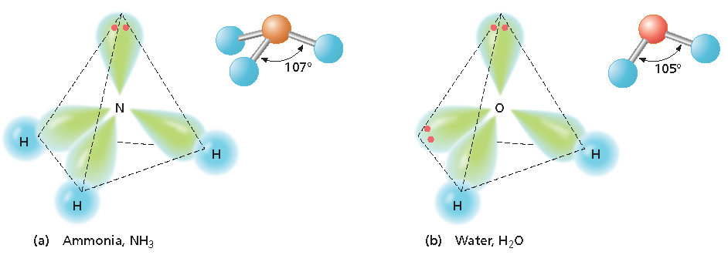
VSEPR Theory, continued
Unshared electron pairs repel other electron pairs more strongly than bonding pairs do.
  This is why the bond angles in ammonia and water are somewhat less than the 109.5° bond angles of a perfectly tetrahedral molecule.

Slide 30
VSEPR Theory, continued
The same basic principles of VSEPR theory that have been described can be used to determine the geometry of several additional types of molecules, such as AB₂E, AB₂E₂, AB₅, and AB₆.
  Treat double and triple bonds the same way as single bonds.
  Treat polyatomic ions similarly to molecules.
  The next slide shows several more examples of molecular geometries determined by VSEPR theory.

Slide 31
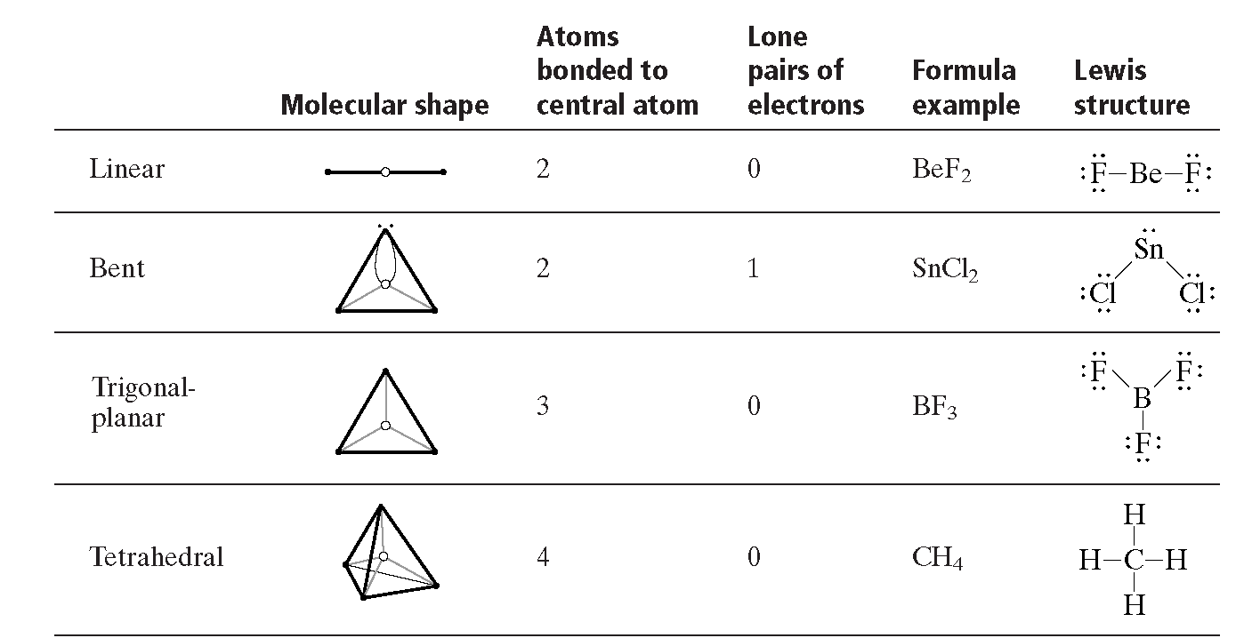
VSEPR and Molecular Geometry

Slide 32
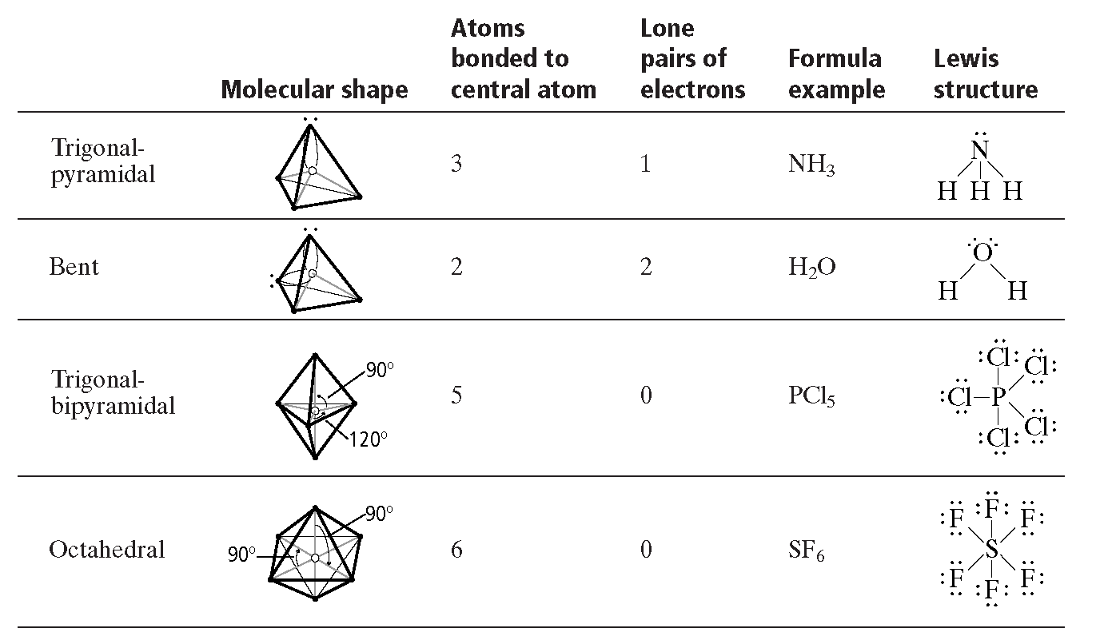
VSEPR and Molecular Geometry

Slide 33
