Slide 1


Chemical Bonds

Slide 2
Honors Chemistry
Ionic Bonding
Last Updated 1 December 2017

Slide 3
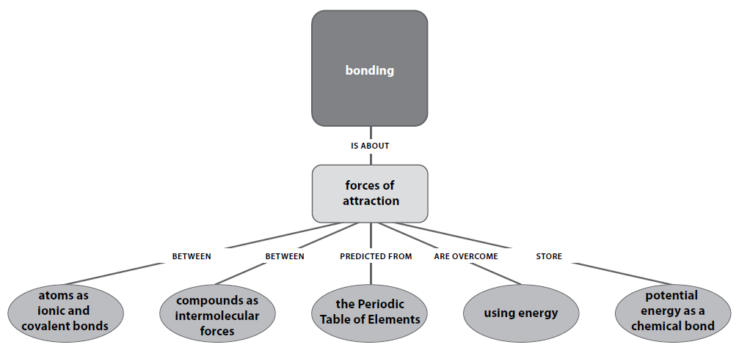
Priority Standards

Slide 4
Big Idea
There are attractions between atoms that increase their stability.

Slide 5
Core Concepts
A chemical bond is the electrostatic attraction between two or more atoms. Chemical potential energy is stored in chemical bonds.
Chemical reactions involve breaking bonds in reactants (endothermic) and forming new bonds in the products (exothermic).
The forces of attraction that occur between molecules (called intermolecular forces) are influenced by molecular polarity. Molecular polarity is dependent on bond polarity (polar or nonpolar) and the shape of the molecule.

Slide 6
Ionic Compounds
Most of the rocks and minerals that make up Earth’s crust consist of positive and negative ions held together by ionic bonding.
  example: table salt, NaCl, consists of sodium and chloride ions combined in a one-to-one ratio—Na⁺Cl–—so that each positive charge is balanced by a negative charge.
An ionic compound is composed of positive and negative ions that are combined so that the numbers of positive and negative charges are equal.

Slide 7
Ionic Compounds
Most ionic compounds exist as crystalline solids.
A crystal of any ionic compound is a three-dimensional network of positive and negative ions mutually attracted to each other.
In contrast to a molecular compound, an ionic compound is not composed of independent, neutral units that can be isolated.

Slide 8
Ionic Compounds, continued
The chemical formula of an ionic compound represents not molecules, but the simplest ratio of the compound’s ions.
A formula unit is the simplest collection of atoms from which an ionic compound’s formula can be established.

Slide 9
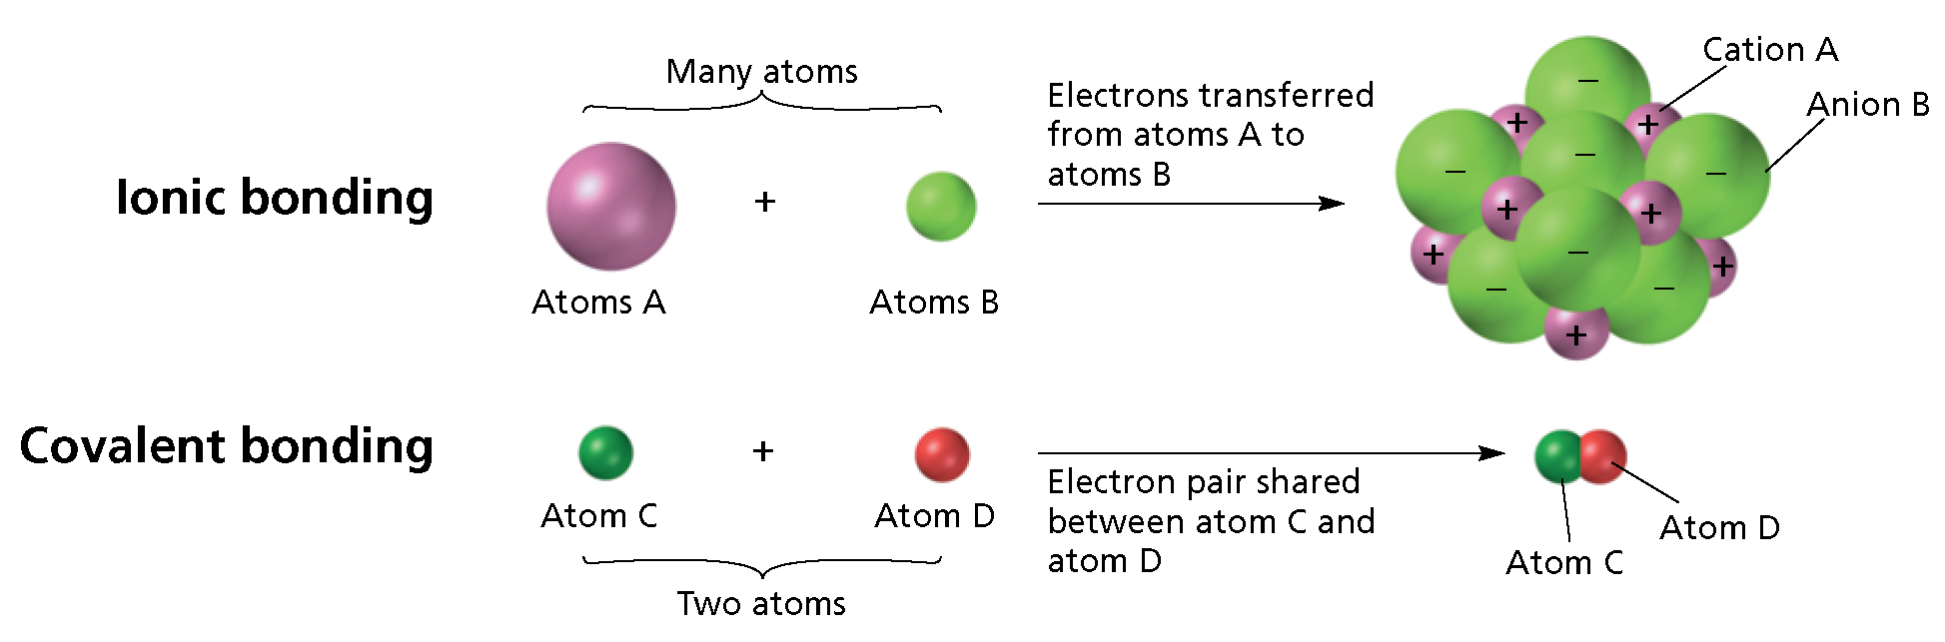
Ionic Vs. Covalent Bonding

Slide 10
Formation of Ionic Compounds
The sodium atom has one valence electron and the chlorine atom has seven valence electrons.
Atoms of sodium and other alkali metals easily lose one electron to form cations.
Atoms of chlorine and other halogens easily gain one electron to form anions.
-

Slide 11
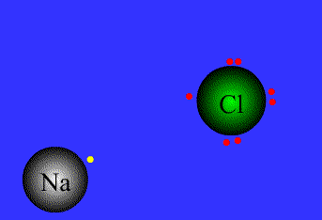

Slide 12
Formation of Ionic Compounds, continued
In an ionic crystal, ions minimize their potential energy by combining in an orderly arrangement known as a crystal lattice.
  Attractive forces exist between oppositely charged ions within the lattice.
  Repulsive forces exist between like-charged ions within
  the lattice.
The combined attractive and repulsive forces within a crystal lattice determine:
  the distances between ions.
  the pattern of the ions’ arrangement in the crystal

Slide 13
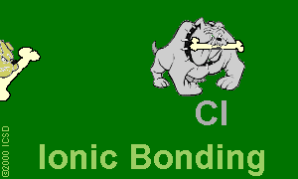
Ionic Bonds: One Big Greedy Thief Dog!

Slide 14
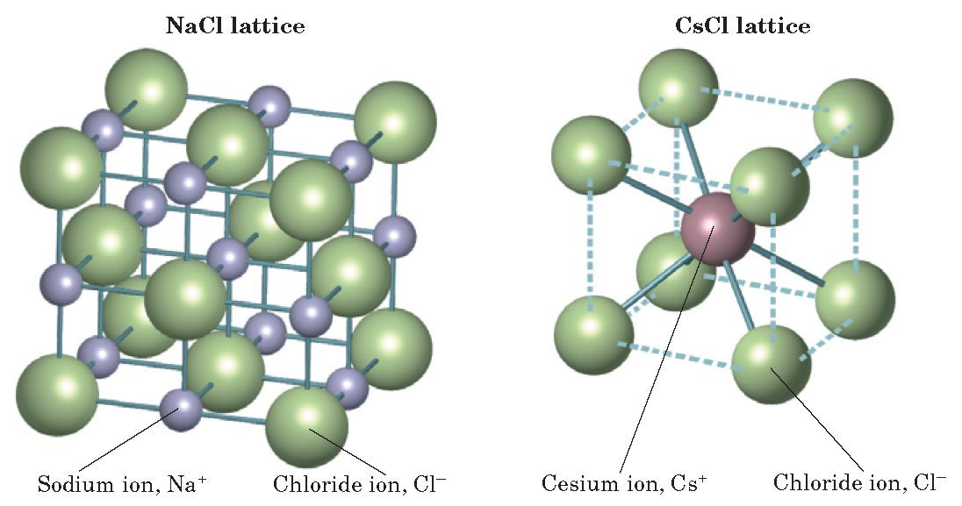
NaCl and CsCl Crystal Lattices

Slide 15
A Comparison of Ionic and Molecular Compounds
The force that holds ions together in an ionic compound is a very strong electrostatic attraction.
The forces of attraction between molecules of a covalent compound are much weaker.
The difference in strength of attraction between the basic units of molecular and ionic compounds
gives rise to different properties between the two
types of compounds.

Slide 16
A Comparison of Ionic and Molecular Compounds,
Molecular compounds have relatively weak forces between individual molecules.
  They melt at low temperatures.
The strong attraction between ions in an ionic compound gives ionic compounds some characteristic properties, listed below.
  very high melting points
  hard but brittle
  not electrical conductors in the solid state, because the ions cannot move

Slide 17
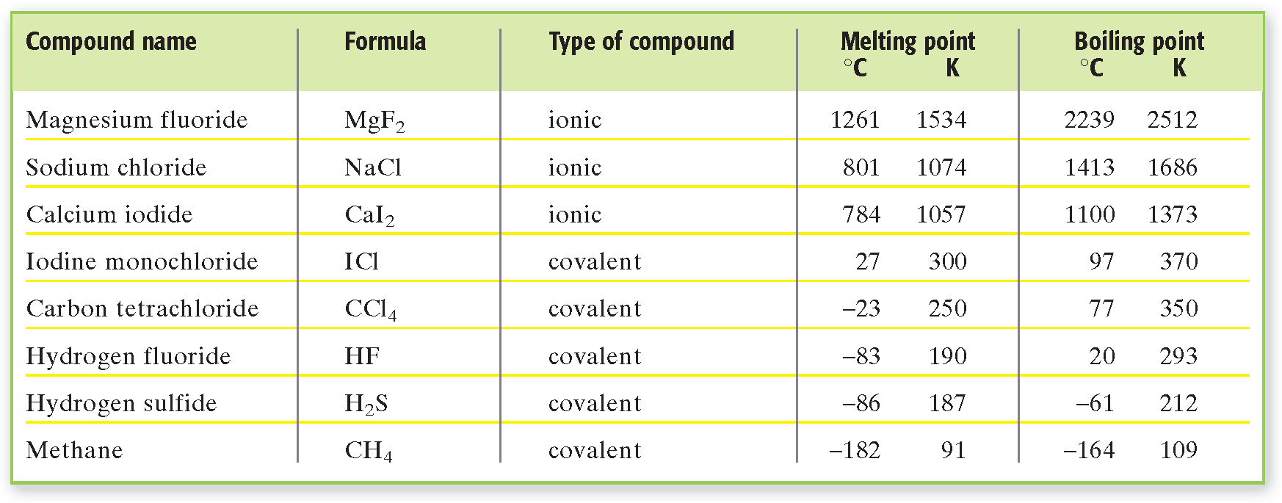
Melting and Boiling Points of Compounds

Slide 18
Polyatomic Ions
Certain atoms bond covalently with each other to form a group of atoms that has both molecular and ionic characteristics.
A charged group of covalently bonded atoms is known as a polyatomic ion.
Like other ions, polyatomic ions have a charge that results from either a shortage or excess of electrons.

Slide 19
Polyatomic Ions
An example of a polyatomic ion is the ammonium
ion: . It is sometimes written as to show that the group of atoms as a whole has a charge of 1+.
The charge of the ammonium ion is determined
as follows:
  The seven protons in the nitrogen atom plus the four protons in the four hydrogen atoms give the ammonium ion a total positive charge of 11+.

Slide 20
Polyatomic Ions, continued
The charge of the ammonium ion is determined
as follows, continued:
  When nitrogen and hydrogen atoms combine to form an ammonium ion, one of their electrons is lost, giving the polyatomic ion a total negative charge of 10–.
  The total charge is therefore (11+) + (10–) = 1+.

Slide 21
Polyatomic Ions, continued
Some examples of Lewis structures of polyatomic ions are shown below.

Slide 22
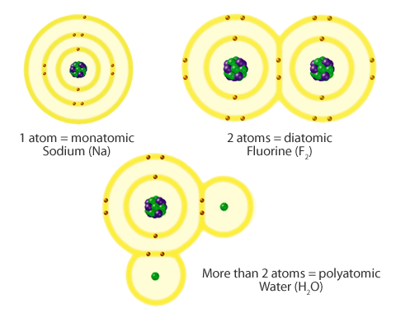

Comparing Monatomic, Polyatomic, and Diatomic Structures

Slide 23
Metallic Bonding
Chemical bonding is different in metals than it is in ionic, molecular, or covalent-network compounds.
The unique characteristics of metallic bonding gives metals their characteristic properties, listed below.
  electrical conductivity
  thermal conductivity
  malleability
  ductility
  Luster→shiny appearance

Slide 24
Metallic Bonding, continued
Malleability is the ability of a substance to be hammered or beaten into thin sheets.
Ductility is the ability of a substance to be drawn, pulled, or extruded through a small opening to produce a wire.

Slide 25

Metallic Bonds: Mellow dogs with plenty of bones to go around.

Slide 26
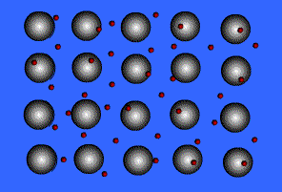
Metallic Bonds, A Sea of Electrons

Slide 27
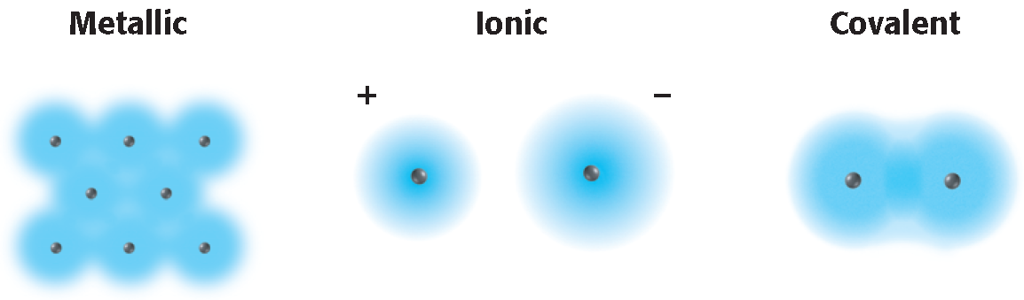
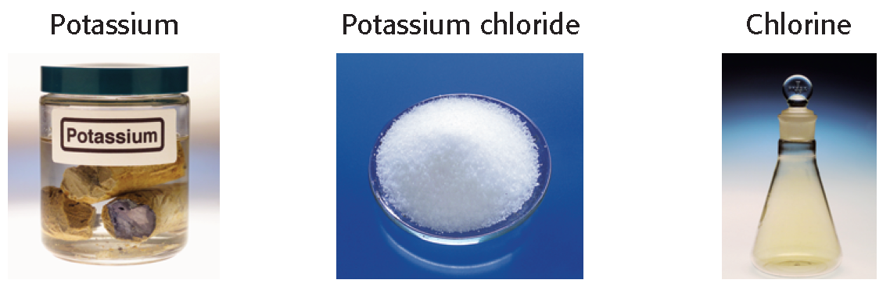
Properties of Substances with Metallic, Ionic, and Covalent Bonds

